Slide 1
Growth Mindset
Presented by University of Mary students:
Catherine Gibbens, Juliana Berger, Catherine Mahrer, Rachel Pankratz, and Peter Foley

Slide 2
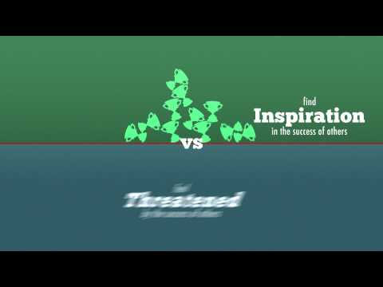
What is Growth Mindset?
An introduction to a Growth Mindset versus a Fixed Mindset

Slide 3
“That feeling of math being hard is the feeling of your brain growing.”
“That’s ok, maybe math will never be one of your strengths.”
“Great effort! You tried your best.”

Slide 4
“That feeling of math being hard is the feeling of your brain growing.”
“Great effort! You tried your best.”

Slide 5
“That feeling of math being hard is the feeling of your brain growing.”

Slide 6
“If you catch yourself saying ‘I’m not a math person’ just add the word ‘yet’ to the end of the sentence.”
“Not everybody is good at math. Just do your best.”
“Do you just not get this?”

Slide 7
“If you catch yourself saying ‘I’m not a math person’ just add the word ‘yet’ to the end of the sentence.”
“Not everybody is good at math. Just do your best.”

Slide 8
“If you catch yourself saying ‘I’m not a math person’ just add the word ‘yet’ to the end of the sentence.”

Slide 9
Growth Statements
“That feeling of math being hard is the feeling of your brain growing.”
“If you catch yourself saying ‘I’m not a math person’ just add the word ‘yet’ to the end of the sentence.”

Slide 10
Why is Growth Mindset Important?-For Teachers
What’s the goal?
ALWAYS learning and improving
Parallels between athletes and students
What does the cross country athlete do differently than other athletes?
Does not have the, “I’m just not good,” attitude.
Why do teachers need a growth mindset?
Because we are the exemplar!
Student can sense when you do not have a growth mindset

Slide 11
Why is Growth Mindset Important?-For Students
Why do students need a growth mindset?
It always comes down to learning and improving.
Learning and improving is not just for test scores, but for life skills.
Accepting criticism, never being afraid of failure, accepting challenges WILLINGLY, seeing setbacks as opportunities to grow, & being someone who enjoys putting in the time and effort to do things well
Students need to know that a growth mindset is not just sheer effort!
It is effort always mixed with LEARNING. Trying and getting nowhere, is not good enough. They need to investigate what to do next.
“The path to the growth mindset is a journey, not a proclamation.” - Carol Dweck
Students need to realize that a growth mindset is something that must be developed. Students are not born with a growth mindset or a fixed mindset.
Notes:
I have more notes in a word document, so I can expand if I have more time to speak. :)

Slide 12
How to Develop a Growth Mindset
Model a growth mindset for your students
Affirm attributes that are in a student’s control
Praise attitude and perseverance
Allow students the right to fail and take risks
Stop doing everything for students and trying to remove all discomfort and pain

Slide 13
Peter’s Story
5th Grade
It was never about the knowledge, and it was always about the grade.
Finally, I was pursuing something because I really wanted to, no matter what anyone thought about it.
It isn’t about what you’re good at, it’s about what you’re willing to work at.
The world became a much more interesting place when I stopped wanting to just appear intelligent and started wanting to really learn.

Slide 14
Resources
Dweck, C. (2015). Carol Dweck revisits the growth mindset. Education Week, 35 (5): 20-24.
Video: Growth vs. Fixed Mindset. Retrieved from https://www.youtube.com/watch?v=brpkjT9m2Oo.
Video: Carol Dweck - A Study on Praise and Mindsets. https://www.youtube.com/watch?v=NWv1VdDeoRY.

